Slide 1


Introducing your Databricks Flight Assistant
Marius Panga Sr. Solutions Architect @ Databricks
Liping Huang Sr. Solutions Architect @ Databricks

Slide 2




Challenges with current AI assistants
Generic responses
Can’t find the right data
Noncompliant with policies
Notes:
Developers increasing use AI assistants, but they still don’t trust them. Generated answers have various issues that make them hard to use. Let’s dive into why. Because models being used are trained on generic code, it can spit out a solution with code that isn’t relevant or very good for what you are working on. When it does get a line of code right, the data it calls may be invented or not the relevant data for what you are trying to do. Finding the right data for a given task can be more challenging than writing the script, and AI assistants can’t help with this.

Slide 3

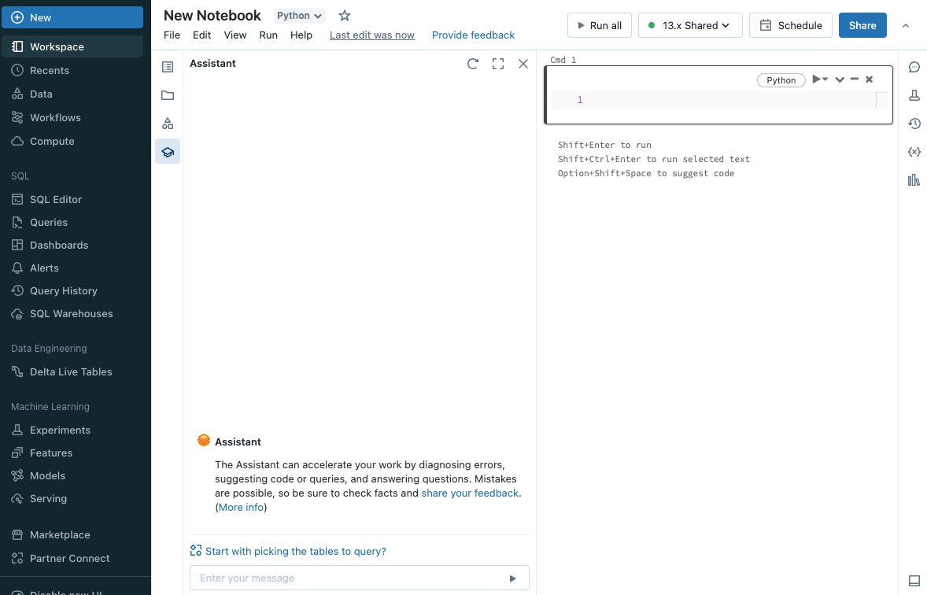
Databricks Assistant
A context-aware AI assistant
Generates SQL queries and code, explains code, and fixes issues Leverages Unity Catalog to provide personalized responses
Available in Databricks Notebooks, SQL editor, and file editor
Notes:
Enter Databricks Assistant. Databricks Assistant is a context-aware AI assistant to help you be more productive in Databricks.
The Assistant leverages Unity Catalog metadata to understand your data and provide personalized responses.
Use it now from Databricks Notebooks, SQL editor, or file editor.

Slide 4

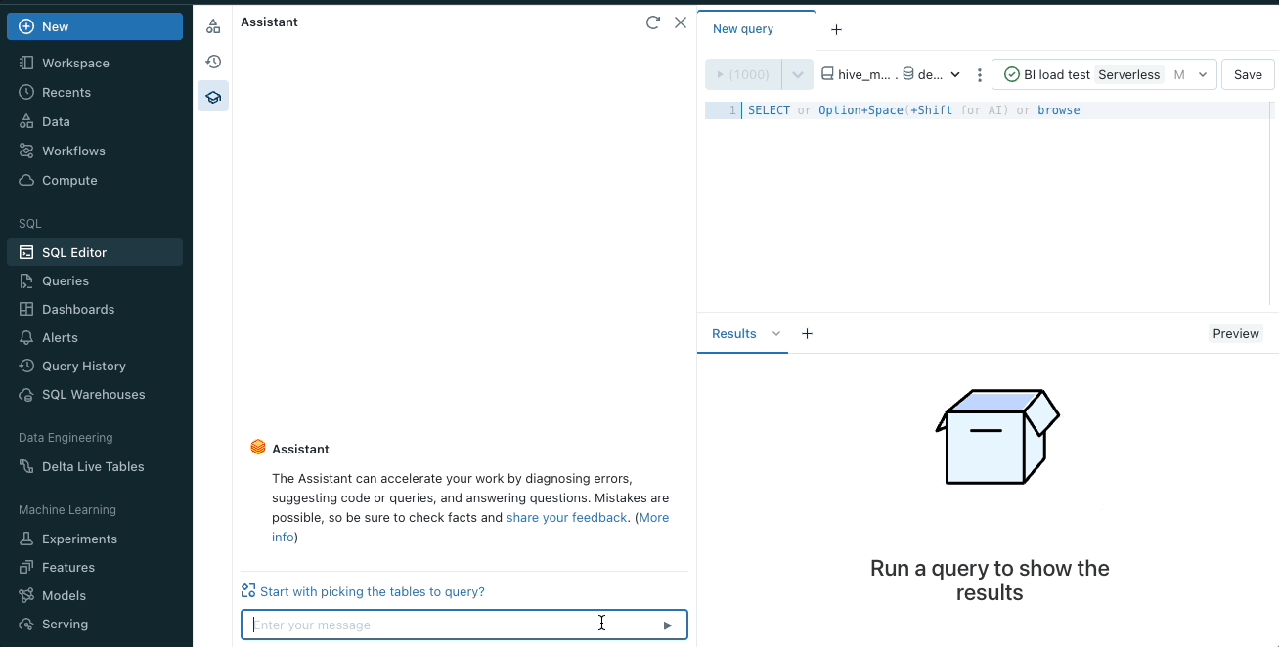
Generates SQL queries and code
Takes requests in natural language and creates code snippets
Applies details from code cells, libraries, runtime, and more to improve accuracy
Explains, diagnoses, and fixes issues from within a cell
Notes:
Let’s go more into how the Assistant helps. The power of AI assistants is that they converse naturally in whatever language the user prefers. The assistant can take requests and create entire SQL queries or blocks of code to execute. You can add these directly into the SQL editor or notebooks, and just run them. To make them more relevant and more accurate, the Assistant is using context from the work you are doing - what code is in the cells you are working with, which tables are you using, and information about your runtime environment and the library you are using. All this gets fed into the assistant to provide better responses. And when there is a bug, the assistant explains in plain language what the issue is and can provide a fix.

Slide 5


Leverages Unity Catalog to provide personalized responses
Applies table schema to locate the right data
Knows popular tables and joins to pick relevant tables
Uses descriptions and tags to understand content
Unity Catalog
hive_metastore
(legacy)
Catalog 2
Catalog 1
default (database)
Database 2
Database 1
customers
(table)
External Table
Views
External Tables
Managed Tables

Slide 6










Available natively in Databricks Notebooks, SQL editor, and file editor
Integrates with existing tools and workstreams
Increases productivity for every user persona - from data engineers and analysts to data scientists

Slide 7

What can you do with Databricks Assistant?

Slide 8
Generate SQL or Python Code
Enter natural language requests to generate code
Use natively from Notebooks, SQL editor, and file editor
Copy code or add it directly into a cell

Slide 9
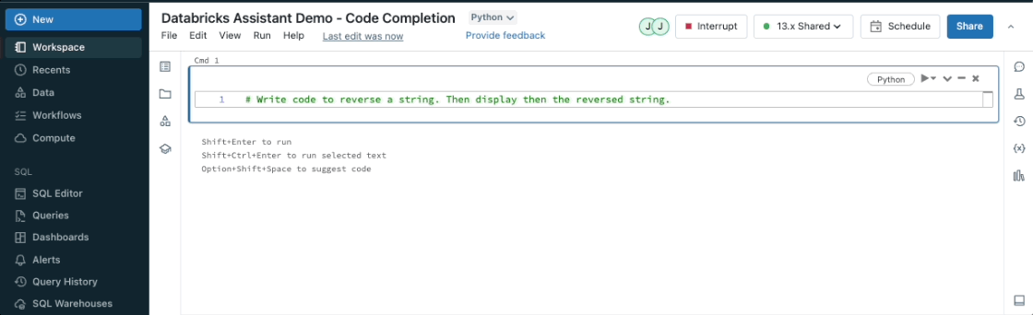
Autocomplete code or queries
Generate code from comments inside a cell or query editor
Control + shift + space (Windows) or option + shift + space (Mac) for autocomplete suggestions

Slide 10
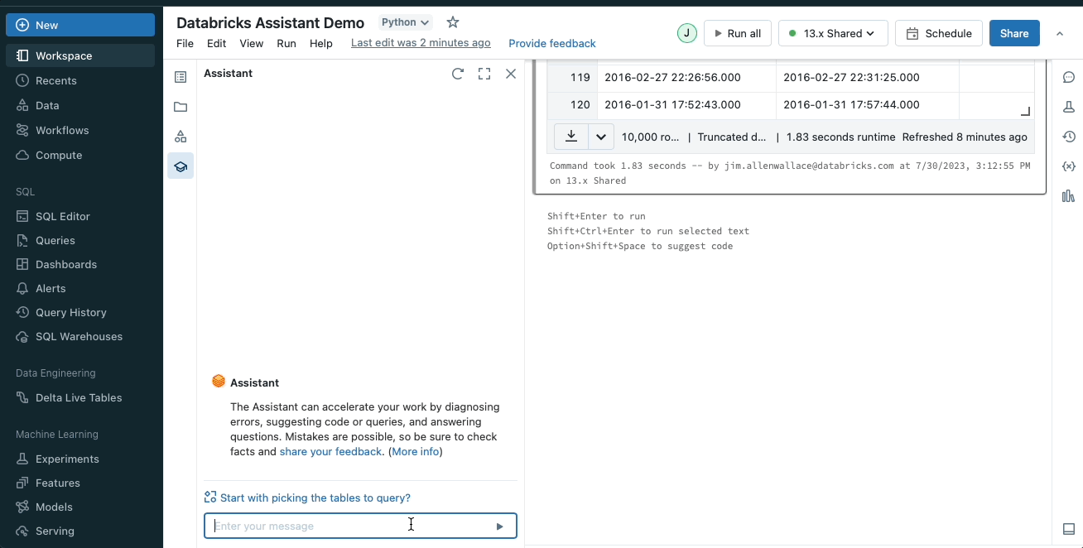
Transform code
Always use the best language for the current task
Utilize alternative frameworks seamlessly

Slide 11
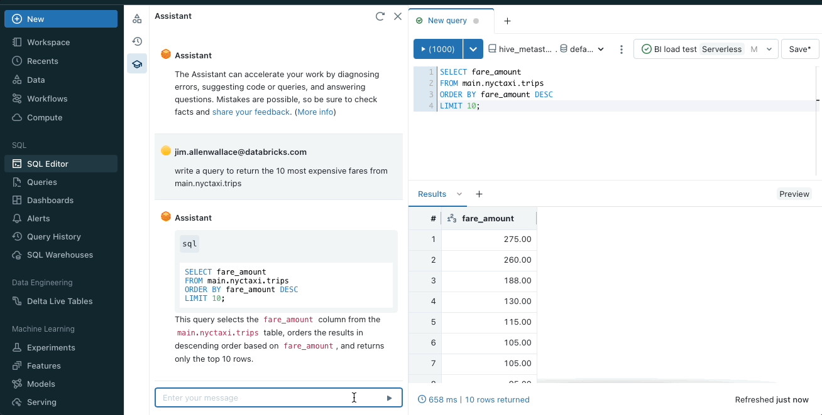
Explain code or query
Get a description of code in clear, concise language
See what data and tables are being used without needing to leave the editor

Slide 12
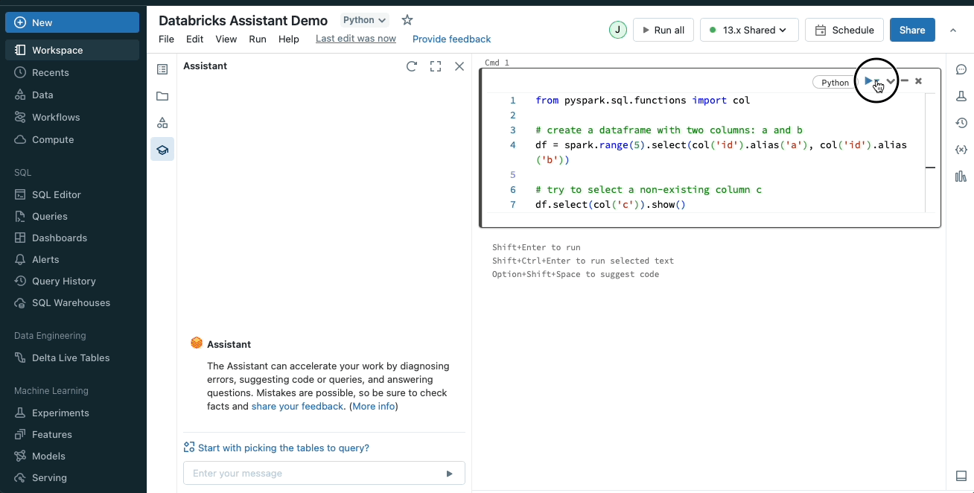
Fix issues
Identify errors and see an explanation of the problem
Receive a recommended fix.
Update the code with the suggested snippet to resolve the issue

Slide 13
Resources
Databricks Assistant docs
5 tips to get the most out of your Databricks Assistant
Databricks Assistant demos

Slide 14
Thank You!

